Slide 1

TechDocs Project Presentation
BY Deployment Team
IIITH-SEDS SEPT22 BATCH

Slide 2
Agenda
Git Hub and PR approval
Front End (FE) server – Creating Load Balancer (LB) and RDS Database Installation
Backend Server - Creating AWS EC2 Linux instance, Creating security groups
CloudWatch Alerts for AWS Resources/ Applications

Slide 3
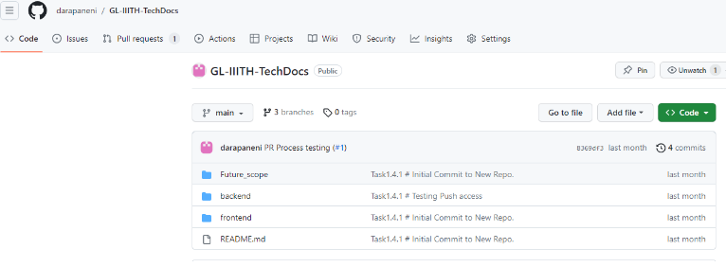
GitHub and PR approval Process
To Manage version of code we have created public repository in GitHub.
GitHub repository link # https://github.com/darapaneni/GL-IIITH-TechDocs/tree/main
This has mainly two default branch’s develop and main branch.
Contributors can create other development branches as and when needed.
For Production code, main is the master branch which will have the latest working code in production.
To merge code in the main branch, a PR approval process is required. At Least two approvals are required on PR process.
Once two contributors are approved then only code can be merged to the main branch.
To request contributor access they can reach out to darapaneni@gmail.com / narayanakukunuri6@gmail.com
Task Owner:
Narayana Kukunuri

Slide 4
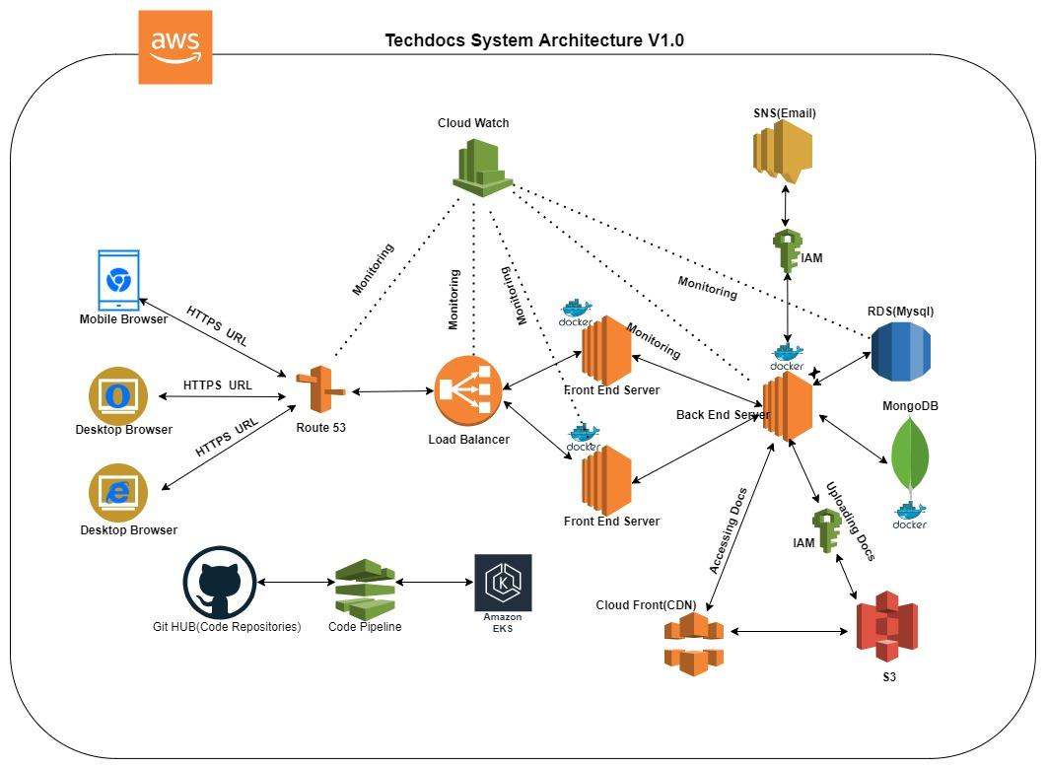
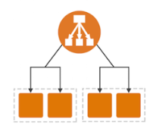
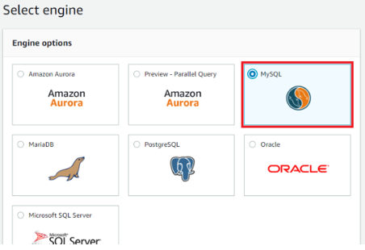
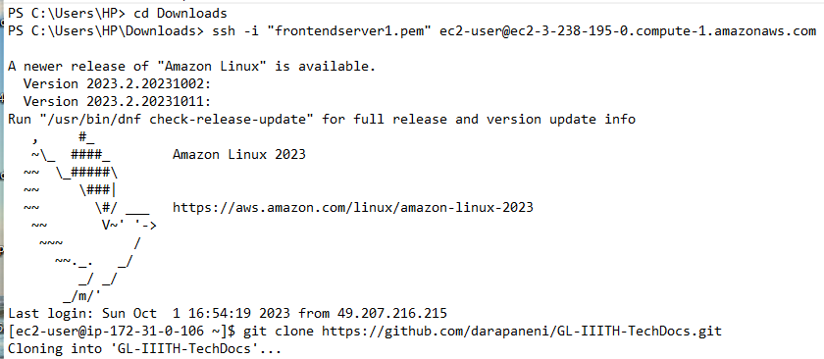
FE Server ALB and RDS Setup in AWS
Application load balancer
Configure RDS service
1
2
Objective: to achieve fault tolerance with zero downtime
Objective: instance dedicated to relational database with high scalability
Tested the old app on the EC2 cluster
Creating ALB
Launch EC2 instances
Create security group
Create a target group (TG)
Create an ALB
Install dockers
Creating MySQL DB on RDS
Create subnet group
Create VPC
Create the database
3
Task Owner:
Guruprasad Srinivasan

Slide 5
Backend Server - Creating AWS EC2 Linux instance, Creating security groups
Amazon EC2 instance created for backend server purpose where backend code could be deployed.
The public IP of the backend server is 52.3.23.133
Security group also created to allow traffic from 80/8080/http/https
User need to have the ‘backendkey.pem’ file to SSH the backend server
Below command to be used to connect to the backend server:
ssh -i "backendkey.pem" ec2-user@ec2-52-3-231-133.compute-1.amazonaws.com
Deployment team has the required steps to deploy the backend code to the server. We already have tested the deployment steps in local env and its working.
Once the AWS console issue is resolved, then backend code can be deployed in the backend server after enabling the port.
Task Owner:
Sandeep Mishra

Slide 6
CloudWatch Alerts for AWS Resources/ Applications
Amazon CloudWatch monitors the Amazon Web Services (AWS) resources and the applications running on AWS in real time.
With CloudWatch, the user gains system-wide visibility into resource utilization, application performance, and operational health.
In the “TechDoc” project, the following CloudWatch Alerts are required for mentioned metrics against each resource/service type:
Frontend Server (EC2):
CPU Utilization, Network In/Out, Disk Read/Writes (for EBS Volumes)
Backend Server (EC2):
CPU Utilization, Network In/Out, Disk Read/Writes (for EBS Volumes)
MySQL RDS:
CPU Utilization, Database Connections, Read & Write Throughput
SNS:
Notifications Delivered, Notifications Failed, Invalid Notifications
Amazon Simple Notification Service (Amazon SNS) coordinates and manages the delivery or sending of messages to subscribing endpoints or clients. Amazon SNS is used with CloudWatch to send messages when an alarm threshold has been reached.
Task Owner:
Ashwani Panwar
Sandeep Mishra

Slide 7
THANK YOU

